Slide 1

INTRODUCTION TO SPRING BOOT
Srinivasulu Yepuru

Slide 2
Objective
At the end of this Session the participants will be able to understand
Basics of Spring Boot
Spring vs Spring Boot
How to develop a Spring boot application.
How enable Security using Spring Boot ?

Slide 3
Prerequisites
Spring framework basics
Spring Dependency Injection,Autowiring.
Spring IOC

Slide 4
Targetted audience
This Session on Spring Boot was planned for the participants of below levels:
Beginner
Intermediate

Slide 5
Tools you need
Maven 3.1+ is your build tool
Your favorite IDE. We use Eclipse.
JDK 1.8+

Slide 6
Spring Boot Introduction

Slide 7
Spring Boot vs Spring MVC vs Spring - How do they compare?
Spring Boot
Spring Boot does not compete with Spring or Spring MVC. It makes them easy to use .
Spring Framework
Most important feature of Spring Framework is Dependency Injection. When DI or IOC is used properly, we can develop loosely coupled applications. And loosely coupled applications can be easily unit tested.
Spring MVC
Spring MVC Framework provides decoupled way of developing web applications. With simple concepts like Dispatcher Servlet, ModelAndView and View Resolver, it makes it easy to develop web applications.

Slide 8
Problem with Spring and Spring MVC

Slide 9
Problem with Spring and Spring MVC
The problem with Spring and Spring MVC is the amount of configuration that is needed.
<bean
class="org.springframework.web.servlet.view.InternalResourceViewResolver">
<property name="prefix">
<value>/WEB-INF/views/</value>
</property>
<property name="suffix">
<value>.jsp</value>
</property>
</bean>
<mvc:resources mapping="/webjars/**" location="/webjars/"/>

Slide 10
Solution Provided By Spring Boot

Slide 11
Solution Provided By Spring Boot
Spring Boot solves this problem through a combination of Auto Configuration and Starter Projects.
Solution 1
Spring Boot also provide a few non functional features to make building production ready applications faster.
Solution 2

Slide 12
Introduction to Spring Boot

Slide 13
Spring Boot – Introduction
Spring Boot is a framework developed on top of core spring framework.
The main aim of Spring Boot is to let developers to create spring production grade applications and services with very less effort.
In Spring includes writing many XML configurations, server setting, adding dependencies…etc.
But with spring Boot we can avoid all these boilerplate code, writing XML configurations and annotations.
We can create a real-time production ready applications within minutes.

Slide 14
Spring Boot – Introduction
Spring Boot comes with inbuilt server, we no longer have to use any external servers like Tomcat, Glass-fish or anything else, so don’t need to deploy WAR files .
The main advantage of Spring Boot is, we can create spring-based applications easily in very less time, without need of any XML configurations.
The main disadvantage is, it will be little tough to migrate existing spring enterprise applications to Spring Boot.
We have to use either Maven or Gradle build tool to work with Spring Boot.

Slide 15
Spring Boot Setup
Spring Boot CLI
Spring Tool Suits (STS)
Spring Initializer

Slide 16
Spring Initializer - Create Spring Boot Projects
Spring Initializer http://start.spring.io/ is great tool to bootstrap your Spring Boot projects.
It allows you to create varied range of Spring Boot based Applications from a very simple UI.
Let’s take the example of creating a Web application with Spring Initializer.

Slide 17
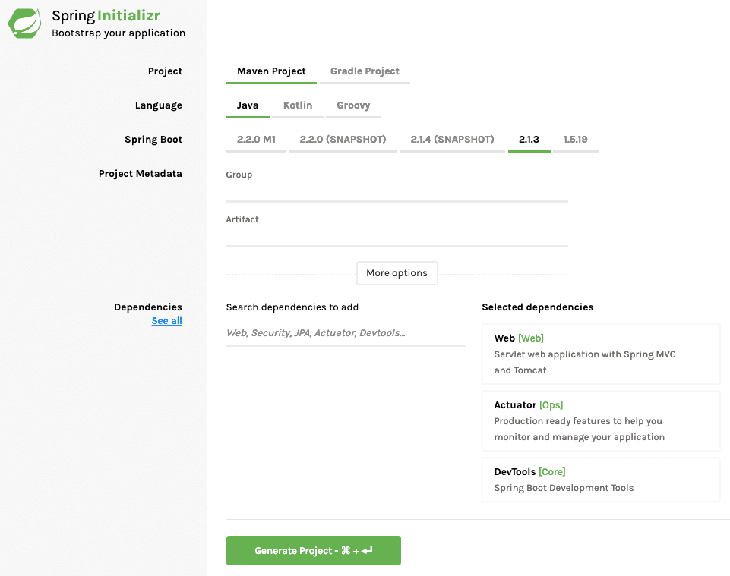
Spring Initializer - Create Spring Boot Projects
Launch Spring Initializer http://start.spring.io/
and choose the following
Choose com.optum.springboot as Group
Choose student-services as Artifact
Choose following dependencies
Web
Click Generate Project button at the bottom of the page.
Import the project into Eclipse.

Slide 18
First Spring Boot Application using Maven

Slide 19
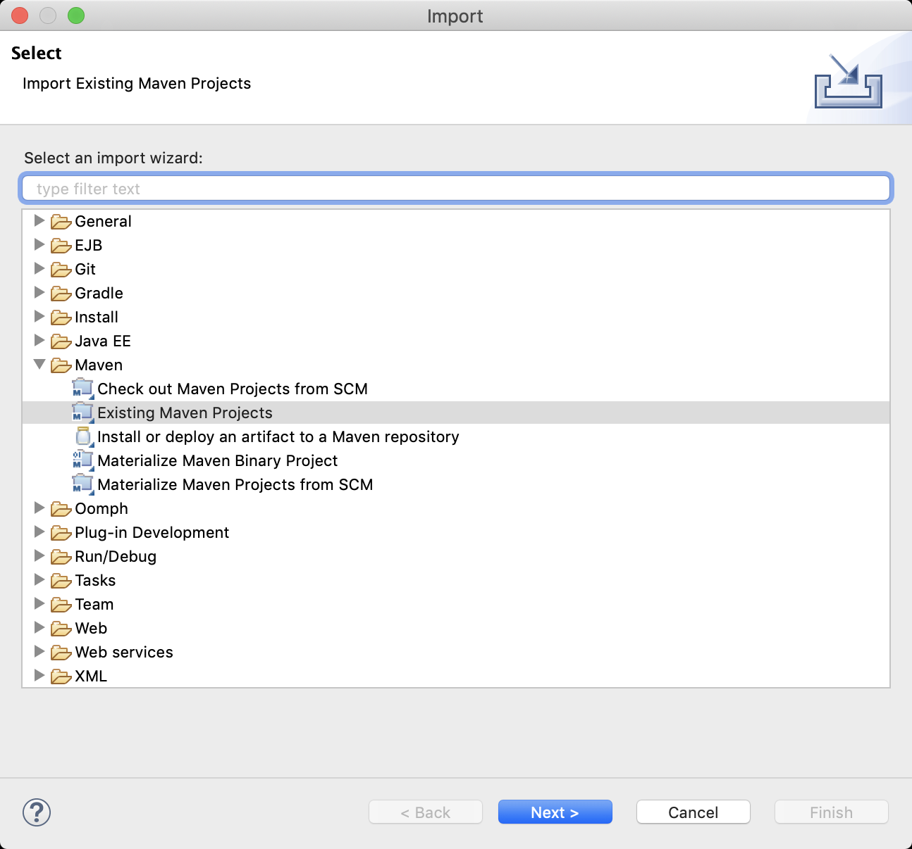
In Eclipse, select File > Import…​ In the import window, expand Maven, select Existing Maven Projects, and click Next:
Import an Existing Maven Project in Eclipse

Slide 20
Spring Boot + Maven
What is Spring Boot Starter Parent?
All Spring Boot projects typically use spring-boot-starter-parent as the parent in pom.xml.
<parent>
<groupId>org.springframework.boot</groupId>
<artifactId>spring-boot-starter-parent</artifactId>
<version>1.4.0.RELEASE</version>
</parent>

Slide 21
Spring Boot + Maven
Parent Poms allow you to manage the following things for multiple child projects and modules:
Configuration - Java Version and Other Properties
Dependency Management - Version of dependencies
Default Plugin Configuration

Slide 22
Spring Boot Hello World Application

Slide 23
Spring Boot Hello World Example
package com.optum.app;
import org.springframework.boot.SpringApplication;
import org.springframework.boot.autoconfigure.SpringBootApplication;
@SpringBootApplication
public class SpringBootApp
{
public static void main(String[] args)
{
SpringApplication.run(SpringBootApp.class, args);
}
}
@SpringBootApplication annotation, means this is the starting point for our Spring Boot application

Slide 24
POM.XML
<parent>
<groupId>org.springframework.boot</groupId>
<artifactId>spring-boot-starter-parent</artifactId>
<version>1.5.6.RELEASE</version>
</parent>
<dependencies>
<dependency>
<groupId>org.springframework.boot</groupId>
<artifactId>spring-boot-starter-web</artifactId>
</dependency>
</dependencies>
<properties>
<java.version>1.8</java.version>
</properties>

Slide 25
What is spring-boot-starter-parent?
This is an existing project given by spring team which contains Spring Boot supporting
configuration data
we have added this in a <parent> tag means, we are instructing Maven to consider our
SpringBootHelloWorld project as a child to it,

Slide 26
What is inside Spring Boot Starter Parent?
First of all - Spring Boot Starter Parent defines spring-boot-dependencies as the parent pom.
It inherits dependency management from spring-boot-dependencies.
<parent>
<groupId>org.springframework.boot</groupId>
<artifactId>spring-boot-dependencies</artifactId>
<version>1.4.0.RELEASE</version>
<relativePath>../../spring-boot-dependencies</relativePath>
</parent>
Default java version is 1.6. A project can override this by specifying a property `1.8.3.1.1

Slide 27
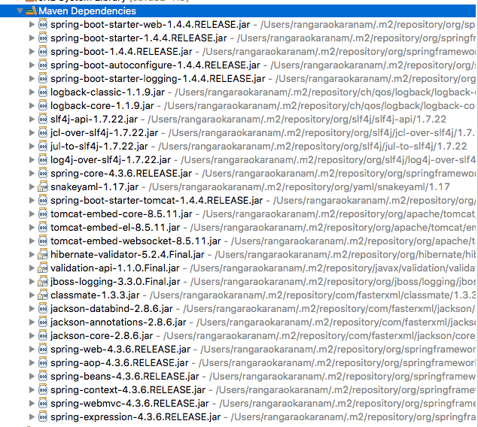
Spring Boot Starter Projects
Let’s consider an example starter – Spring
Boot Starter Web.
If you want to develop a web application or
an application to expose restful services,
Spring Boot Start Web is the starter to pick.

Slide 28
Spring Boot Starter Projects
Spring Boot Starter Web brings them together and provides a simple approach to use them.
Spring - core, beans, context, aop
Web MVC - (Spring MVC)
Jackson - for JSON Binding
Validation - Hibernate Validator, Validation API
Embedded Servlet Container - Tomcat
Logging - logback, slf4j
Any typical web application would use all these dependencies.
As a developer, I would not need to worry about either these dependencies or their compatible versions.

Slide 29
Spring Boot starter Projects

Slide 30
Spring Boot starter Projects
Spring Boot provides a wide range of starter projects. Spring Initializer supports all of them and
more.
spring-boot-starter-web-services : For building applications exposing SOAP Web Services
spring-boot-starter-web - Build Web applications & RESTful applications
spring-boot-starter-test - Write great Unit and Integration Tests
spring-boot-starter-jdbc - Traditional JDBC Applications
spring-boot-starter-hateoas - Make your services more RESTful by adding HATEOAS features
spring-boot-starter-security - Authentication and Authorization using Spring Security
spring-boot-starter-data-jpa - Spring Data JPA with Hibernate
spring-boot-starter-cache - Enabling Spring Framework’s caching support
spring-boot-starter-data-rest - Expose Simple REST Services using Spring Data REST

Slide 31
Spring Boot with RESTful Web Services

Slide 32
How to Create a RESTful Web Service ?
To create a RESTful Web Service using Spring Boot ,we use below annotations.
@RestController,
@RequestMapping
The annotation @RestController, tells Spring Boot to consider this class as REST controller.
The annotation @RequestMapping register the controller with a path inside it.

Slide 33
Example :@RestController, @RequestMapping
@RestController
public class SpringJavaController {
@RequestMapping("/")
public String welcome() {
return "Welcome to Spring Boot ";
}
@RequestMapping("/hello")
public String myData() {
return "Hello Spring Boot";
}
}

Slide 34
Spring Boot Component Scan

Slide 35
How spring boot knows to scan our controller?
SpringJavaController.java
package com.optum.app.controller;
import org.springframework.web.bind.annotation.RestController;
import org.springframework.web.bind.annotation.RequestMapping;
@RestController
public class SpringController {
@RequestMapping("/")
public String welcome() {
return "Welcome to Spring Boot Tutorials";
}
@RequestMapping("/hello")
public String myData() {
return "Hello Spring Boot";
}
}

Slide 36
How spring boot knows to scan our controller?
If you create the controller class outside of the main package, let's say com.optum.controller, If
you run the application it gives 404 error, just give a try and see 🙂
What’s the solution for this?
we have to add @ComponentScan annotation in our Spring Boot main class, something like this..
@SpringBootApplication
@ComponentScan(basePackages="com.optum.controller")
public class SpringBootApp {
public static void main(String[] args){ ---
}
}

Slide 37
Tomcat Default Port Settings

Slide 38
How to Change Default Tomcat Server Port
when we start the application Spring Boot’s inbuilt tomcat server by default will take 8080 as its port number.
We can change that default tomcat’s port number 8080 to something else.
Ex:
application.properties
server.port = 2020

Slide 39
Change Default Context Path

Slide 40
How to Change Default Context Path
what is this context path?
simply its our application name.
Generally, while we are hitting any application in the browser, we will write the URL with the
application name(context).
Ex:
application.properties
server.contextPath=/yourApplicationName

Slide 41
Reload the Changes in the Server

Slide 42
How to Reload Changes Without Restarting the Server
One of the main challenge for the java developers is to deploy the apps and restart server when ever there is a code change.
We can simplify with the help of Spring boot to reload the code changes without having
to restart the server.
In Spring Boot this can be achieved by adding a DevTools module, just add the following dependency in your Spring Boots pom.xml and build it.

Slide 43
How to Reload Changes Without Restarting the Server
In Spring Boot this can be achieved by adding a DevTools module, just add the following
dependency in your Spring Boots pom.xml and build it.
<dependency>
<groupId>org.springframework.boot</groupId>
<artifactId>spring-boot-devtools</artifactId>
<optional>true</optional>
</dependency>

Slide 44
Deploy the Application into External Server

Slide 45
How to Deploy Spring Boot Applications on External Tomcat Server
Ex:
<!-- to export as WAR -->
<dependency>
<groupId>org.springframework.boot</groupId>
<artifactId>spring-boot-starter-tomcat</artifactId>
<scope>provided</scope>
</dependency>
<!-- packaging to WAR -->
<packaging>war</packaging>
we used to deploy and run the applications using embedded tomcat server provided by the spring boot.
Generally, in the real-time projects we wont use inbuilt servers provided by the frameworks because of many reasons like security, maintenance and control.
You want to deploy it on to external tomcat server

Slide 46
Auto Configuration?

Slide 47
Why do we need Spring Boot Auto Configuration?
Spring based applications have a lot of configuration.
When we use Spring MVC, we need to configure component scan, Dispatcher Servlet, a view resolver,
web jars(for delivering static content) among other things.
<bean
class="org.springframework.web.servlet.view.InternalResourceViewResolver">
<property name="prefix">
<value>/WEB-INF/views/</value>
</property>
<property name="suffix">
<value>.jsp</value>
</property>
</bean>
<mvc:resources mapping="/webjars/**" location="/webjars/"/>

Slide 48
Why do we need Spring Boot Auto Configuration?
Spring Boot looks at
a) Frameworks available on the CLASSPATH
b) Existing configuration for the application.
Based on these, Spring Boot provides basic configuration needed to configure the application
with these frameworks. This is called Auto Configuration.
Ex:
import org.springframework.boot.autoconfigure.SpringBootApplication;
import org.springframework.context.ApplicationContext;
@SpringBootApplication
public class SpringBootApp{
@Autowired
private ApplicationContext context;
}

Slide 49
Beans in Application Context

Slide 50
Display All Beans Available in ApplicationContext
To show you how to see the beans that are loaded by the Spring Boot from the ApplicationContext.
@SpringBootApplication
public class SpringBootApp implements CommandLineRunner {
@Autowired
private ApplicationContext context;
public static void main(String[] args) {
SpringApplication.run(SpringBootApp.class, args);
}
@Override
public void run(String...args) throws Exception {
String[] beans = context.getBeanDefinitionNames();
for (String bean: beans) {
System.out.println(bean);
}
}
}

Slide 51
Restful web services with XML response

Slide 52
How to Create a RESTful Web Service ?
To create a RESTful Web Service using Spring Boot ,we use below annotations.
@RestController,
@RequestMapping
The annotation @RestController, tells Spring Boot to consider this class as REST controller.
The annotation @RequestMapping register the controller with a path inside it.

Slide 53
How to Create a RESTful Web Service ?
SpringJavaController.java
package com.optum.app.controller;
import org.springframework.web.bind.annotation.RestController;
import org.springframework.web.bind.annotation.RequestMapping;
@RestController
public class SpringJava4sController {
@RequestMapping("/")
public String welcome() {
return "Welcome to Spring Boot Tutorials";
}
@RequestMapping("/hello")
public String myData() {
return "Hello Spring Boot";
}
}

Slide 54
How to Create a RESTful Web Service with GET Request with XML response
Spring boot services by default gives the response in JSON format,
but we can reverse this functionality in such a way that the default response will be in XML.
In order to do that we have to add a new dependency called jackson-dataformat-xml.
<dependency>
<groupId>com.fasterxml.jackson.dataformat</groupId>
<artifactId>jackson-dataformat-xml</artifactId>
</dependency>

Slide 55
Spring Boot Security

Slide 56

Agenda
Basic Authentication
Authorization
Form Based Authentication
JWT Authentication
Q&A

Slide 57
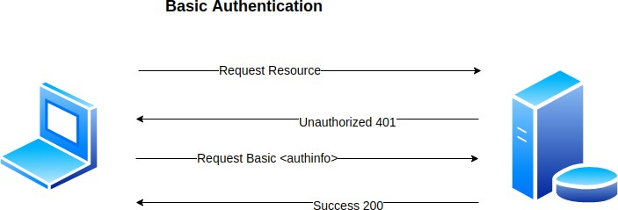
Basic Authentication
It is the simplest of authentication mechanisms. It is a part of HTTP protocol. It is a challenge response scheme where the server challenges the client to provide necessary information to access the resource
How does it work?
Get the username and password from user
Encode it using base64 algorithm
Set it in the Authorization header and send it along each HTTP Request.
GET Request | Basic64:username:password

Slide 58
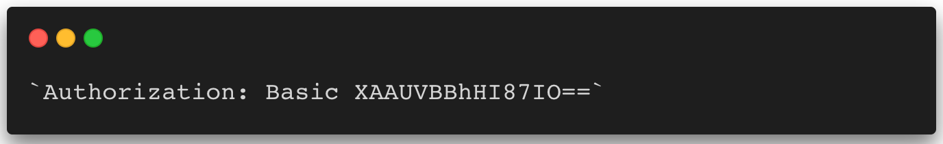
Basic Authentication
Advantages
Easy and simple to implement
APIs are faster since there is no complex encryption/decryption involved
Disadvantages
Basic Auth implemented in a non-SSL (HTTPS) network is a huge security vulnerability. It is easy to decode an Base64.
Sending passwords over all the HTTP request provides a pool of requests for attackers to pick passwords from. Once they crack one the system becomes open for attacks.

Slide 59

User
UserName (Unique)
Password (Encoded) Role
Authority / Privileges Locked
Expires

Slide 60
Authorization
Authorization is something that happens once the user logs into the system. Does an user have access to a specific information? For example, in a library the lenders need not know the billing/vendor information related to each book. In a system that involves more than one type of stakeholders, the authorization is as important of authentication.
Access-Control
Authorization is achieved using access control, you can imagine it as a “Restricted Area” sign with a guard.
Types of Access Control
RBAC - Role Based Access Control - A user with specific roles can access specific data. E.g., Only a Super Admin can change the Locale of the system. MAC - High security systems avail these kinds of access control
DBAC White-Lists & Black-Lists - Discretionary Access Control - The business data decides which information is available for a specific user.

Slide 61

Role
Read
Read
Write
Role: Admin
Role: User
Permission X1 Permission X2 Permission X3 Permission Y1 Permission Y2 Permission Y3
Permission X1 Permission X2 Permission X3

Slide 62
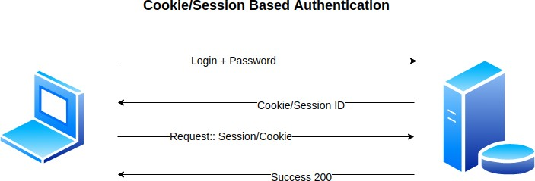
Form Based Authentication (Cookie / Session)
Cookie/Session based authentication is the most used in web apps. Yes, both session and cookie are not the same but the conceptually either the client uses a cookie/session to identify itself as a logged in.
How does it work?
Get the username and password from user
Set it in request form params and send it to the server
Server validates the user based on the given username and password
Once successful validation, create a cookie and set it in the response
The client then uses this cookie/session to make future requests.

Slide 63
Form Based Authentication (Cookie / Session)
Advantages
We no longer set the password in every request making the window for attacks smaller.
Enables state maintenance in a stateless system. Cookies maintain the state that the user is already logged in.
Can revoke the validity of a cookie anytime.
Disadvantages
Cookie based authentication is suitable only for Single domain system. If you want both a web and a mobile app or may be a separate client server.

Slide 64
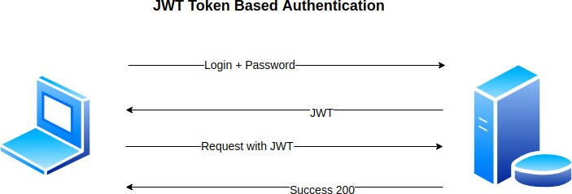
Token Based Authentication(JWT)
Token Based Authentication is a form of stateless authentication. Instead of sending email and password over for authentication we use a server generated token. Oauth, JWT, Open ID all comes under token-based authentication
How does it work?
User submits a username and password
Server validates and returns a singed token JWT
Use the token to allow future requests

Slide 65
Token Based Authentication(JWT)
Advantages
The server no longer have to bear the overhead of session information
Works well on microservices architecture.
Disadvantages
Cannot revoke the access to a user.
The safety of the token relies on the consumer of the token.

Slide 66
References
Spring Security 5.x.x
https://start.spring.io/
https://spring.io/projects/spring-security
https://docs.spring.io/spring- security/site/docs/5.3.4.RELEASE/reference/html5/
https://docs.spring.io/spring- security/site/docs/5.3.4.RELEASE/api/
https://docs.spring.io/spring- boot/docs/current/reference/html/appendix-application- properties.html#security-properties

Slide 67

Any Questions ?

